Slide 1
Welcome to Psy 652 Lab! Module 8: Matrix Algebra & Multivariate Correlations

Slide 2
Objectives
Matrix Algebra
Multivariate Correlations
Indexing from a Matrix

Slide 3
Matrix Algebra

Slide 4
Matrix algebra
Today we will be working with matrices in R
A matrix is a 2-dimensional array of numbers.
In R, a matrix requires that all your data take on the same type of class (i.e. character, numeric or logical).
This is what separates it from a data frame - Which allows values of any class to be together
Today, we will be using matrix algebra to obtain a multivariate correlation (A correlation with multiple X’s and Y’s)

Slide 5
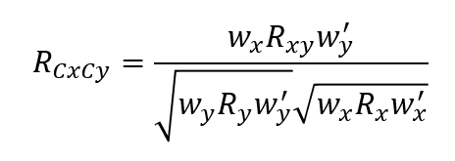
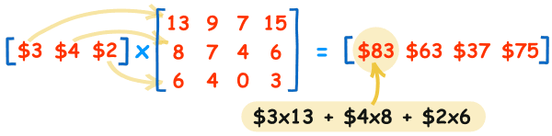
How does matrix algebra work?
Matrix 1
Matrix 2
Outputted Matrix
Each bracket is a matrix
Notice how we multiply a 1x3 matrix by a 3x4 matrix.
This spits out a 1 x 4 matrix. Order matters in matrix multiplication
You need the # of columns in matrix 1 to match the # of rows in matrix 2.
We will be using this method to obtain the multivariate correlation (Equation on top right)

Slide 6
Indexing Variables from a Matrix

Slide 7
Indexing Variables from a matrix
Today we will be “indexing” variables from a matrix
This is equivalent to “selecting” (via select() ) and filtering (via filter() ) variables in a dataframe
However, we are working with a matrices and select()/filter() won’t work on matrices.
Instead, we need to tell R which variables we want with brackets - “[ , ]”
Indexing works as so:
Matrix_name[rows, columns]
To the left of the comma are all of the rows you want to filter to. To the right of the comma is all of the columns you want to select.
I provide examples on the next slide

Slide 8
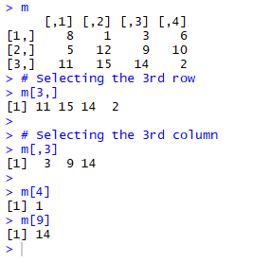
Some examples
Matrix_name[2,3]
Takes the second row and the third column of your matrix
Matrix_name[,3]
Takes every row from the third column (blank spaces before a comma indicate “Take it all”)
Matrix_name[3,]
Takes third row and every column
Matrix_name[1:3,2:4]
A colon indicates, “here to there”. This matrix takes rows 1 to 3 and columns 2 to 4.
Matrix_name[1:5,]
Takes rows 1 to 5 and every column.

Slide 9
Some notes
Indexing can also be done on dataframes and is quite efficient.
But select() and filter() are much more intuitive!
So keep using those!
We won’t be using it much in this class! Mostly just this module!

Slide 10
Multivariate Correlations

Slide 11
Multivariate correlation
The correlation of 3+ variables
The goal of today will be to find the multivariate correlation of a series of X’s (Predictors) and multiple Y’s (Outcomes/Criterions)
Additionally, We will learn how to weight variables
Weighting variables indicates which variables are of more important in your study.

Slide 12
The Multivariate Equation

Slide 13
The Multivariate Equation
Weighted* correlation matrix of our x’s & y’s
Weighted* correlation matrix of our y’s
Weighted* correlation matrix of our x’s
* The weight is chosen by YOU!

Slide 14
Let’s code!

